Slide 1
inflation-adjusted, before-tax, money income for the median American household has stagnated since the mid-70s. (Today only about 18% higher.)
Inflation-adjusted hourly money wages for the median, non-supervisory worker has hardly budged.

Slide 2
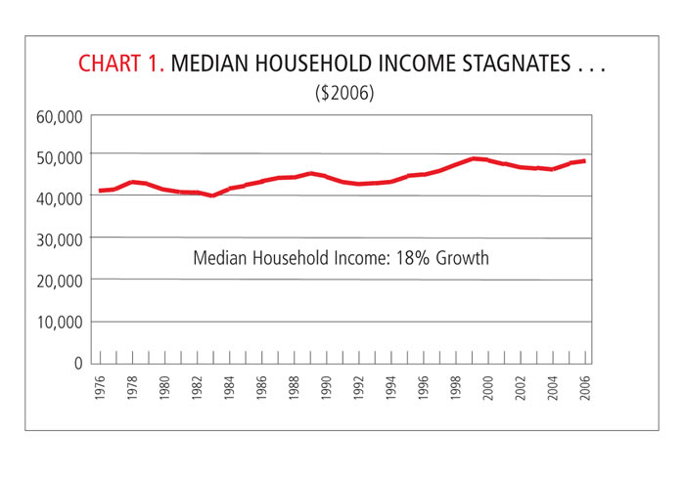
Real Household Income

Slide 3
In 2012 dollars,
average hourly earnings for
non-supervisory workers in
1975 were $4.73. In 2012
dollars that’s $19.70.
Today, they’re $20.42 – higher
by a mere 3.6 percent

Slide 5
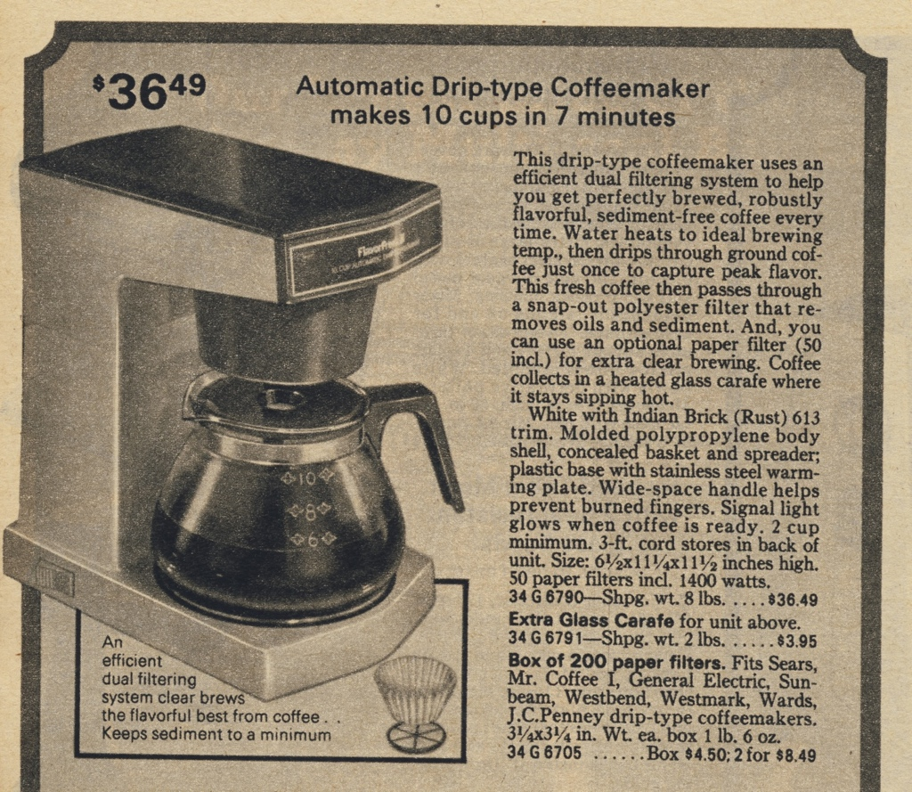
7.7 hours

Slide 6
2012
40 minutes

Slide 7
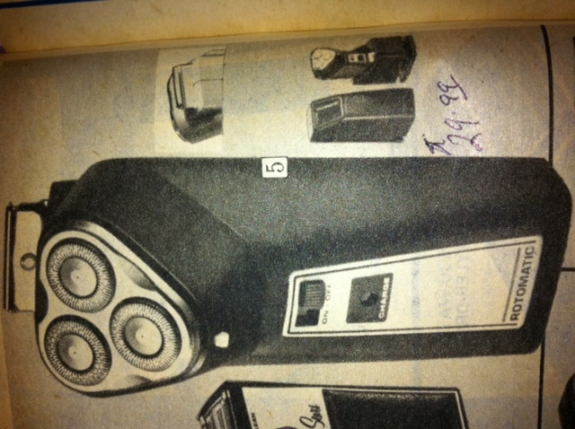
6.3
hours

Slide 8
2 hours

Slide 9
1.5 hours

Slide 10
1 hour

Slide 11
7 hours

Slide 12
4.4 hours
(So, 11.4
hours total)

Slide 13
5.5 hours
And it’s got
wheels!

Slide 14
9 hours

Slide 15
4.9 hours

Slide 16
15.8 hours

Slide 17
5.4 hours

Slide 18
13 minutes

Slide 19
3.8 minutes

Slide 20
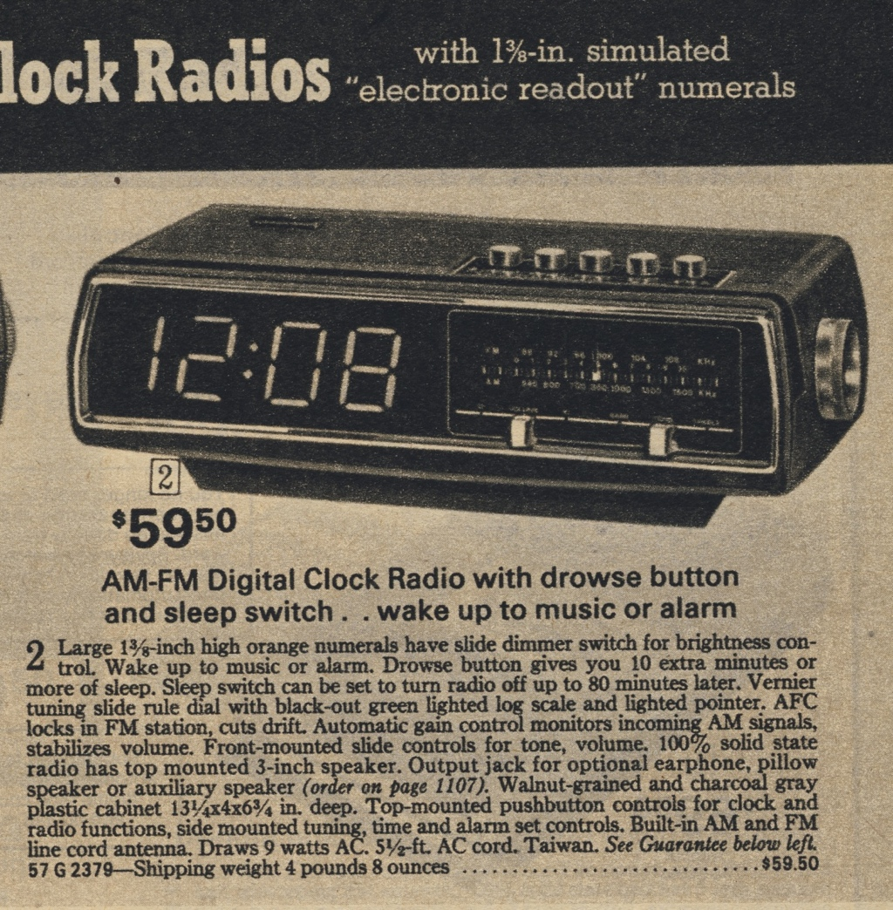
12.6
hours

Slide 21
30
minutes

Slide 22
57
hrs.

Slide 23
52
hrs.

Slide 24
73.4
hours

Slide 25
1 hour, 52 minutes

Slide 26
44 hours

Slide 27
11 hours

Slide 28
8.6 hours

Slide 29
4.0 hours

Slide 30
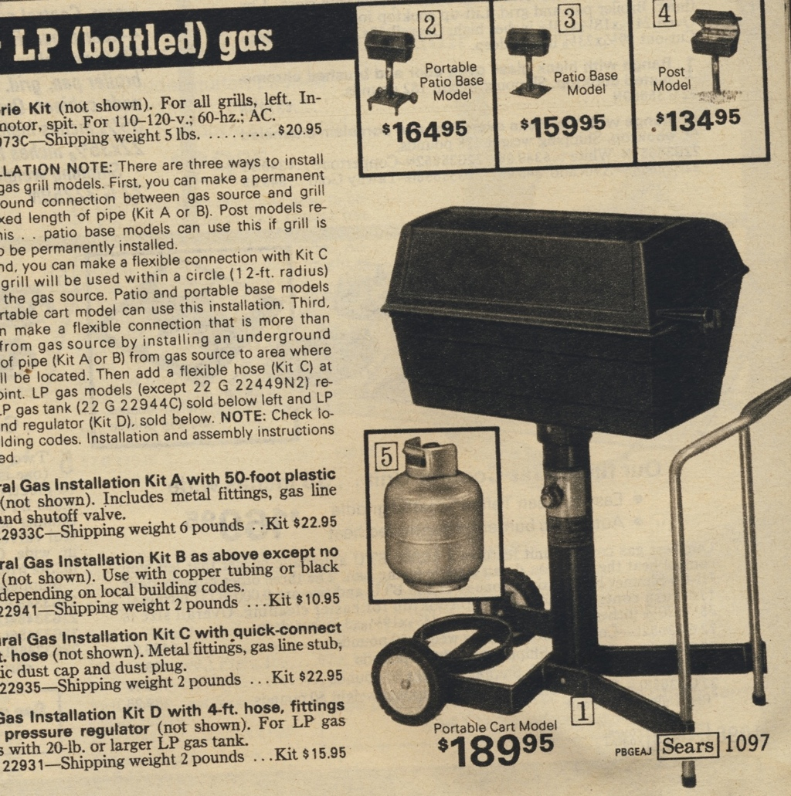
40.2
hours

Slide 31
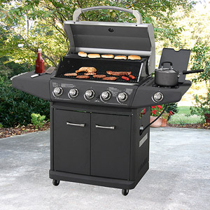
13.1
hours

Slide 32
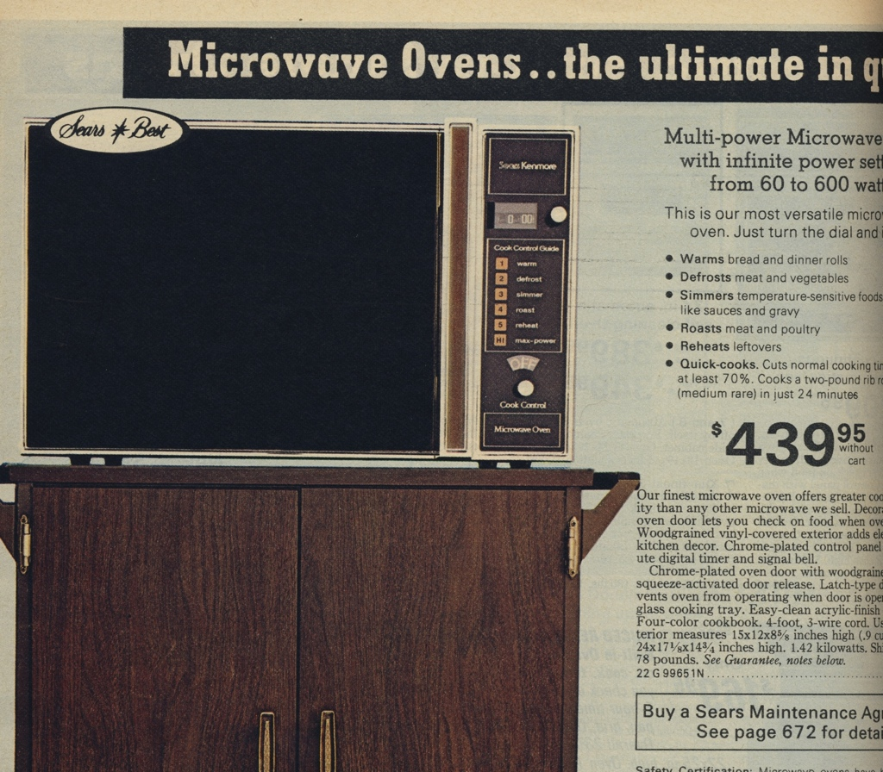
93
hours

Slide 33
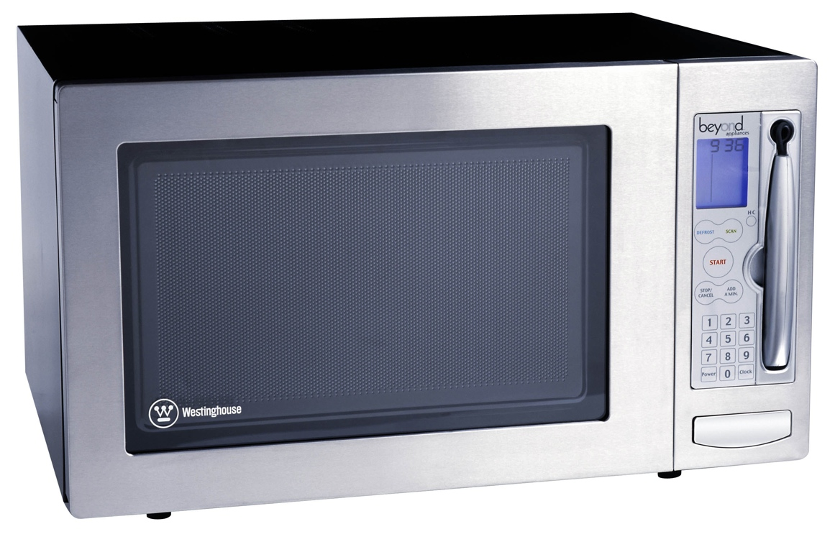
4 hours

Slide 34
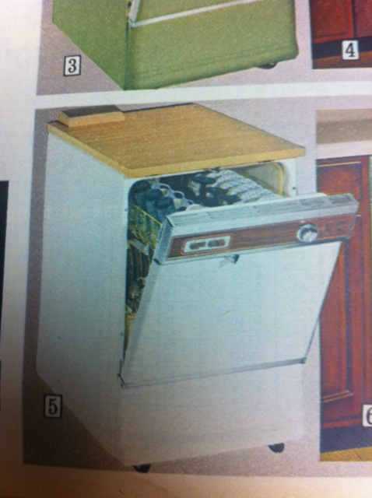
48.6 hours

Slide 35
12.2 hours

Slide 36
2.9 hours

Slide 37
1.5 minutes

Slide 38
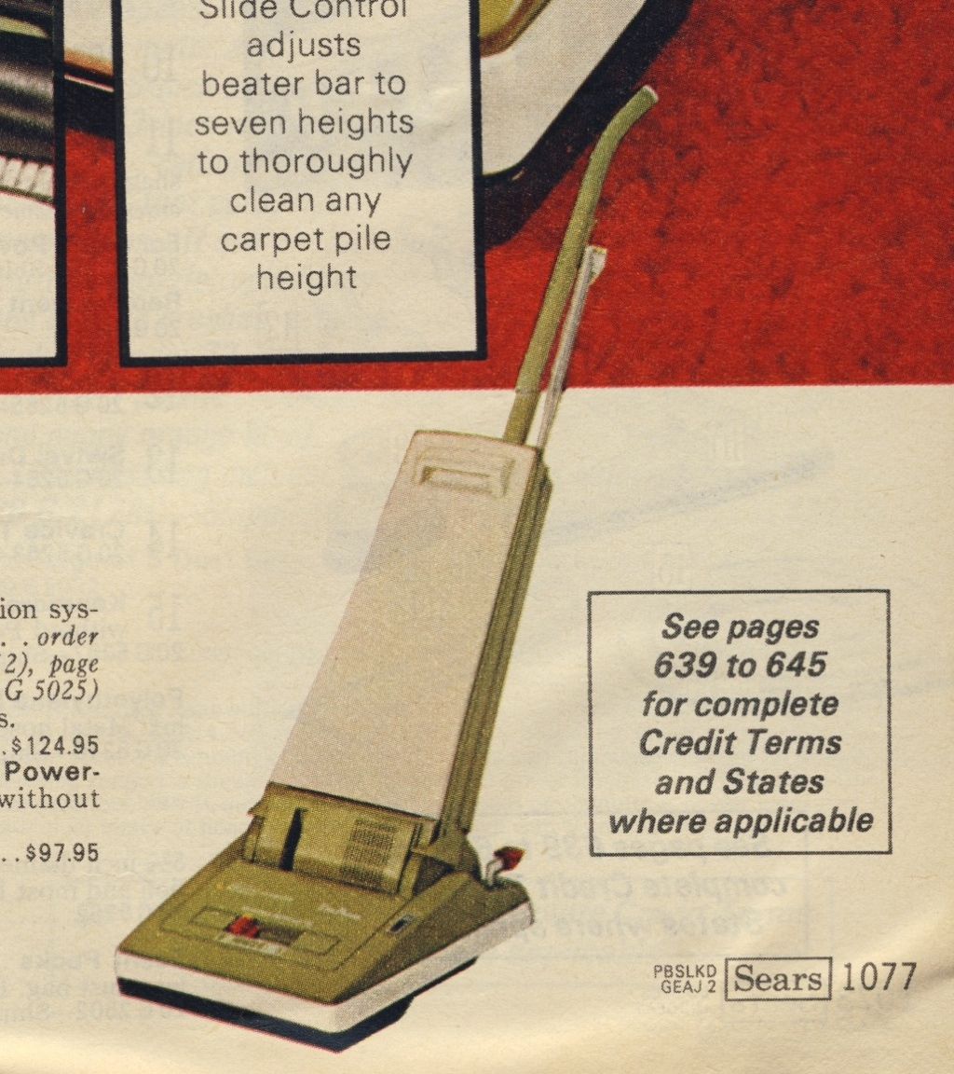
26.4 hours

Slide 39
3.9 hours

Slide 40
12.7 hours

Slide 41
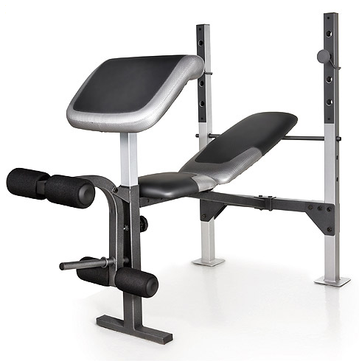
3.9 hours

Slide 42
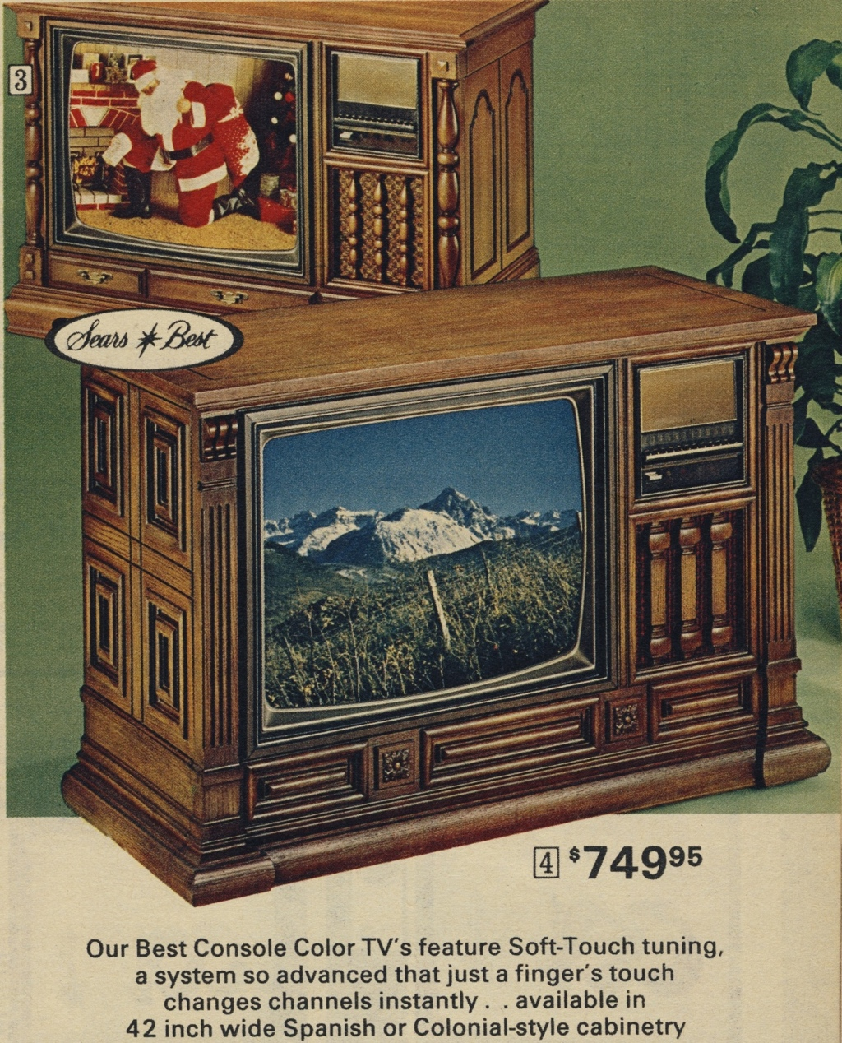
158.6 hours

Slide 43
17.1 hours

